Slide 1
Equity
Science and scenarios
Abatement costs
Instruments for emission reduction
Impacts of climate change; valuation
Economic impacts; marginals; distribution
Impacts and development
Adaptation policy
Optimal climate policy
Discounting, uncertainty, equity
Measuring preferences

Slide 2
Optimal Climate Policy
International agreements
First-best climate policy
Ancillary benefits
Time discounting
Uncertainty
Equity
Equity weights
All together now
How to choose ethical parameters

Slide 3
Optimal emission reduction
Climate change is long-term, uncertain , global problem
If you do not care about the distant future , remote probabilities, far-away lands, you do not care about climate change

Slide 5
Differences in Values
Impacts of climate change differ greatly between countries
Initially, people just added the monetised climate change impacts
This caused a furore, as health risks were valued differently depending on income
The value of a statistical life is an empirical quantity, and cannot be changed
One future Nobel laureate suggested to use the global average value
Instead, one can use different weights for different countries

Slide 6
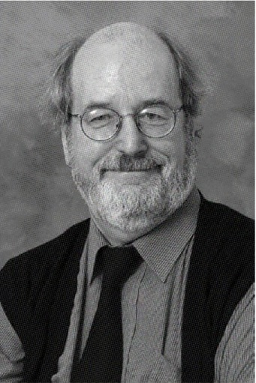
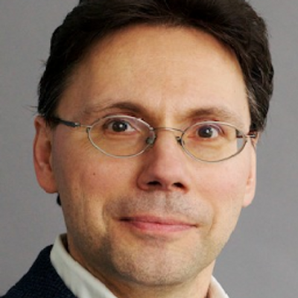
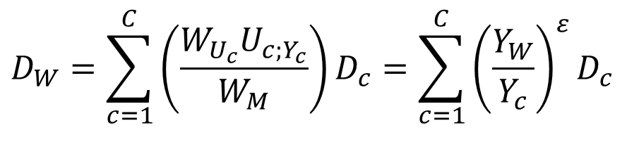

Equity Weights
Fankhauser, Pearce & Tol
This could imply equal values
$$D_{W}=\sum_{c=1}^{C}{\left(\frac{W_{U_{c}}U_{c;Y_{c}}}{W_{M}}\right)D_{c}}=\sum_{c=1}^{C}{{\left(\frac{Y_{W}}{Y_{c}}\right)}^{ε}D_{c}}$$
$$D_{W}=\sum_{c=1}^{C}{{\left(\frac{Y_{W}}{Y_{c}}\right)}^{ε}D_{c}}=\sum_{c=1}^{C}{{\left(\frac{Y_{W}}{Y_{c}}\right)}^{ε}V_{c}I_{c}}= \\ \sum_{c=1}^{C}{{\left(\frac{Y_{W}}{Y_{c}}\right)}^{ε}V_{W}{\left(\frac{Y_{c}}{Y_{W}}\right)}^{η}I_{c}}\overset{ε=η}{=}\sum_{c=1}^{C}{V_{W}I_{c}}$$

Slide 7
Social cost of carbon, $/tC
 | No | Equity weights
ρ ε | 0 | 0.5 | 1.0 | 2.0
0% | 101.49 |  | 182.12
1% | 15.56 | 19.37 | 27.86 | 45.11
3% | 0.66 |  | 1.16

Slide 8
Optimal Climate Policy
International agreements
First-best climate policy
Ancillary benefits
Time discounting
Uncertainty
Equity
Equity weights
All together now
How to choose ethical parameters

Slide 9
Optimal emission reduction
Climate change is long-term, uncertain, global problem
If you do not care about the distant future, remote probabilities, far-away lands, you do not care about climate change

Slide 10
No equity, no uncertainty

Slide 12
No equity, no uncertainty
Equity, no uncertainty

Slide 13
No equity, no uncertainty
No equity, uncertainty

Slide 14
No equity, no uncertainty
Equity, no uncertainty
No equity, uncertainty
Equity, uncertainty

Slide 16
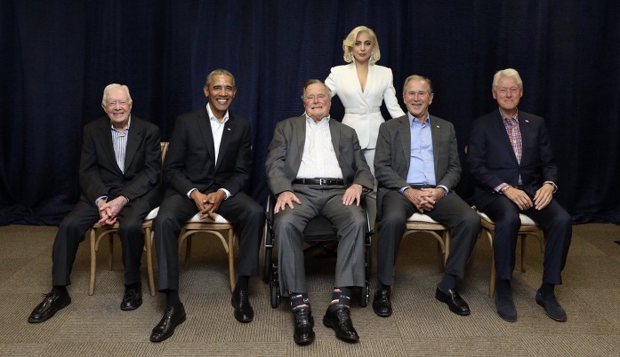
What values
The rates of pure time preference, inequity aversion, and risk aversion describe how much we care about the future, others, uncertainties
Two approaches to such ethical parameters
Philosophy, religion
Would what Aristotle, Jesus, Lao Tzu, Mohammed, Lord Stern, Lady Gaga do?
Revealed preferences
What does the average person do?
Consistency is crucial
If you don’t care about Africa in your trade policy, why do you care about Africa in your environmental policy?

